Slide 1
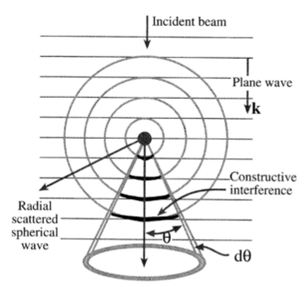
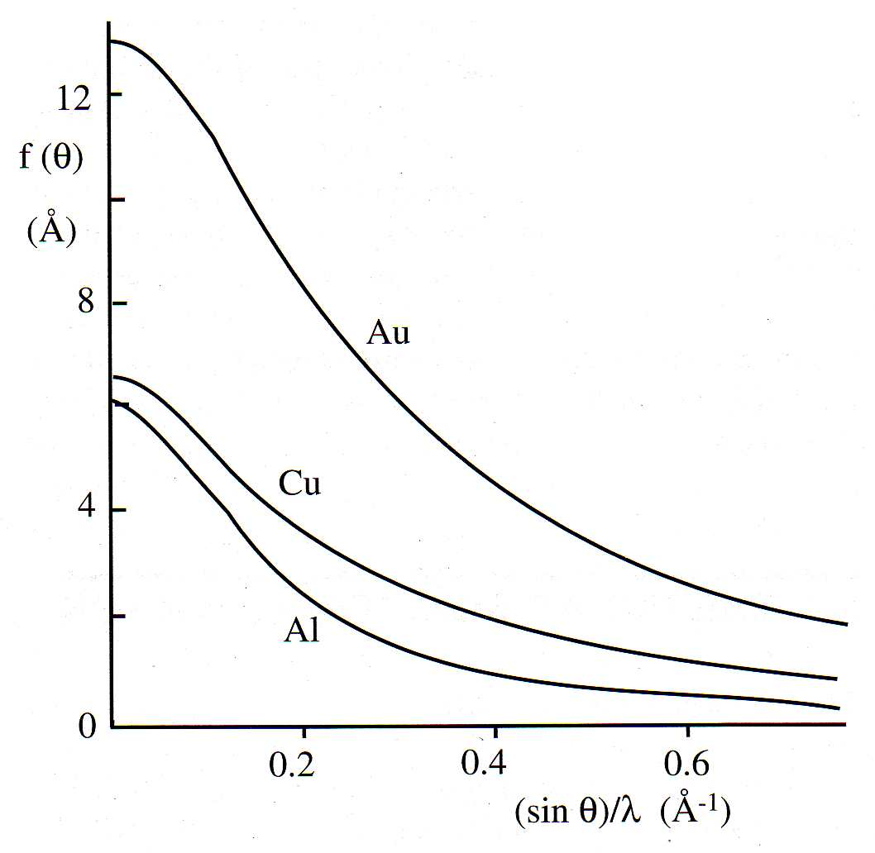

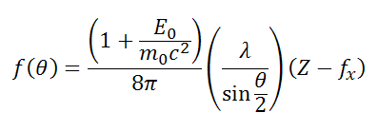


Scattering theory - Atomic scattering factor
Consider coherent elastic scattering of electrons from atom
Atomic scattering factor for electrons
Differential elastic scattering
cross section:
The Mott-Bethe formula is used to calculate electron form factors from X-ray form factors (f_{x})

Slide 2
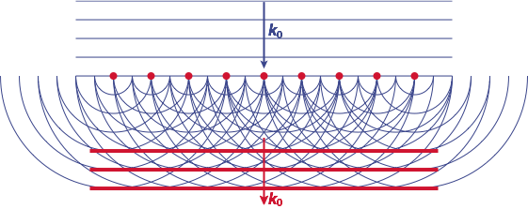
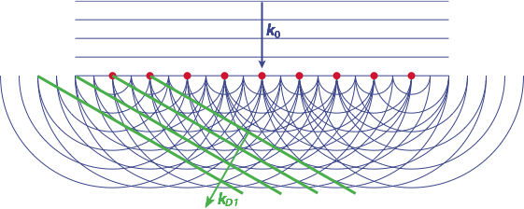
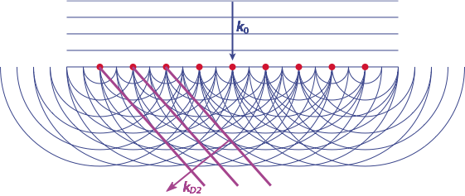
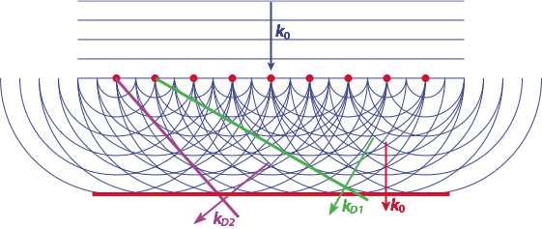
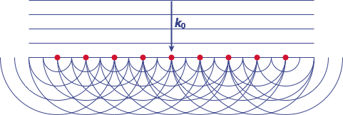
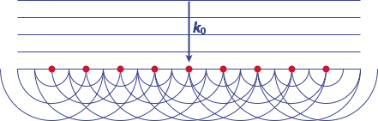
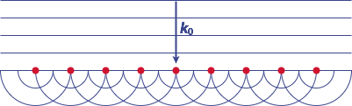
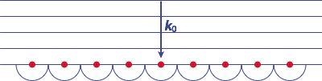
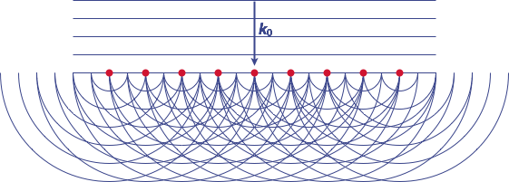
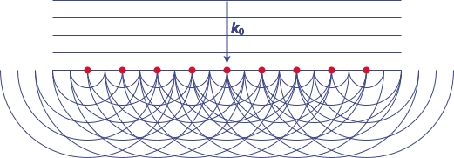

Scattering theory - Huygen’s principle
Periodic array of scattering centres (atoms)
Plane electron wave generates secondary wavelets
Secondary wavelets interfere =>
strong direct beam and multiple orders of diffracted beams from constructive interference
Atoms closer together => scattering angles greater
=> Reciprocity!

Slide 3
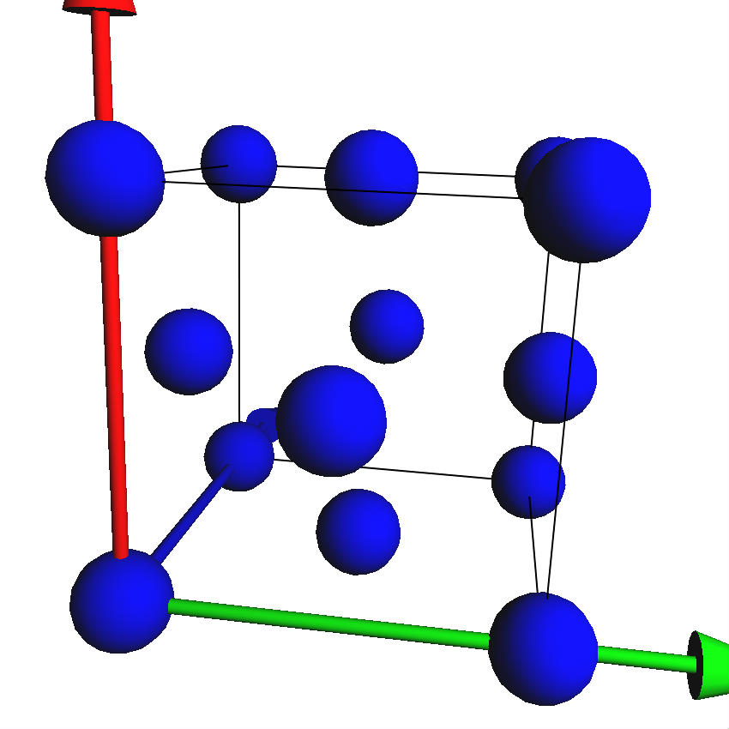
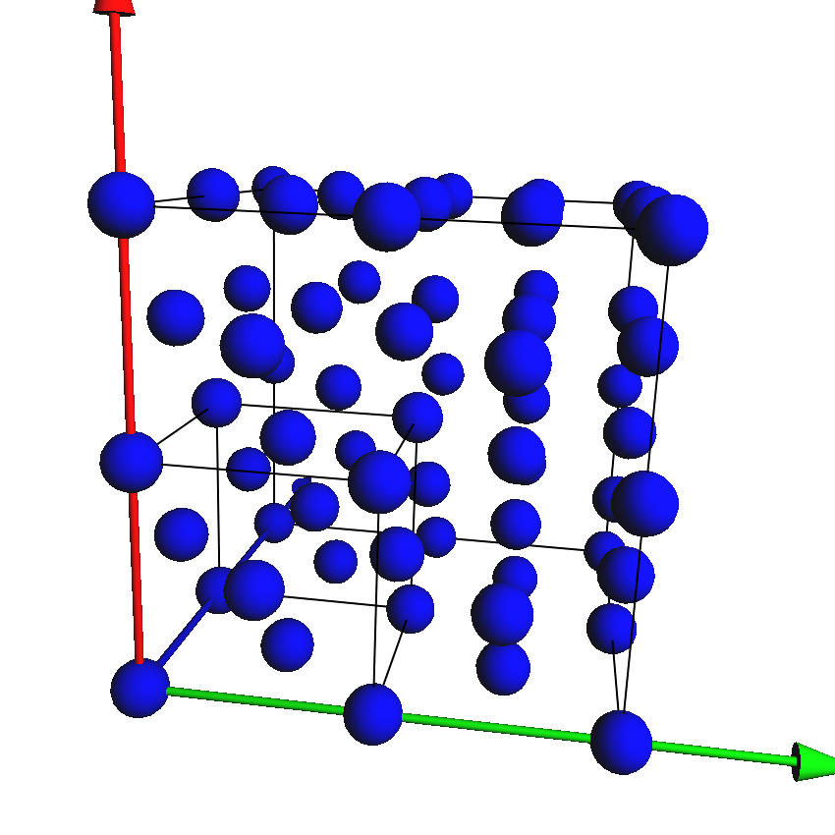
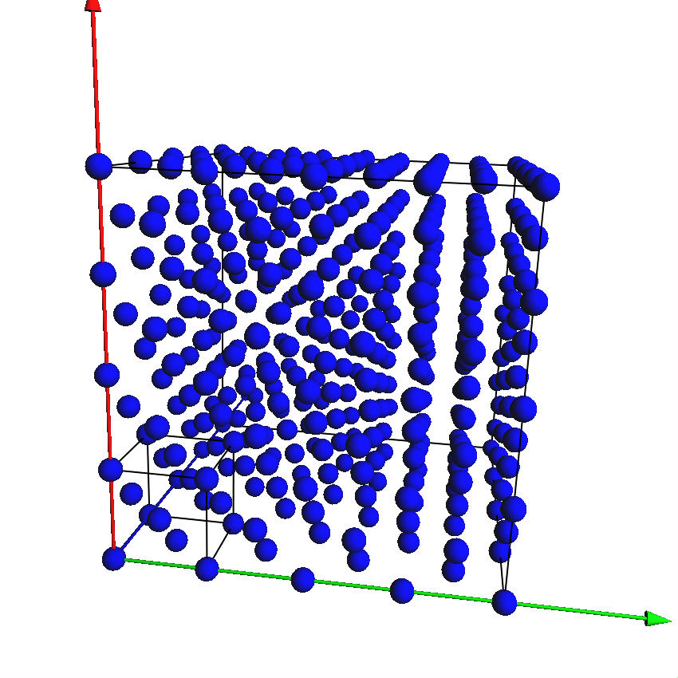
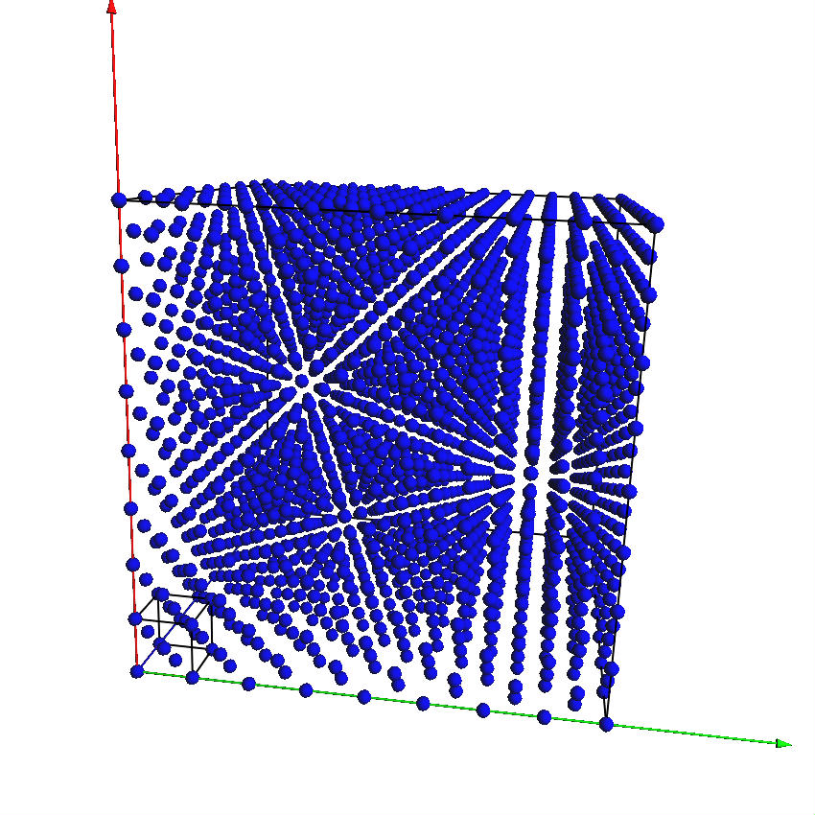
Basic crystallography
Crystals: translational periodicity & symmetry
Repetition of translated structure to infinity

Slide 4
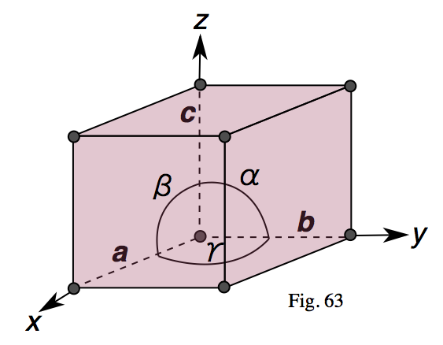
Crystallography: the unit cell
Unit cell is the smallest repeating unit of the crystal lattice
Has a lattice point on each corner (and perhaps more elsewhere)
Defined by lattice parameters a, b, c along axes x, y, z
and angles between crystallographic axes: α = b^c; β = a^c; γ = a^b

Slide 5
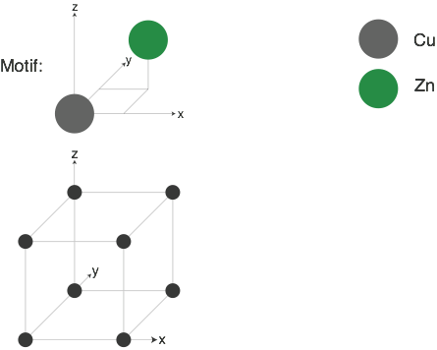
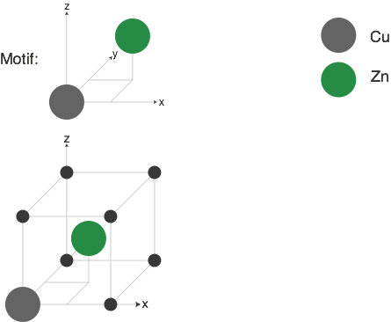
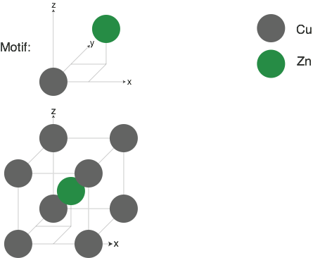
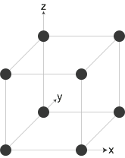
Building a crystal structure
Use example of CuZn brass
Choose the unit cell - for CuZn: primitive cubic (lattice point on each corner)
Choose the motif - Cu: 0, 0, 0; Zn: ½,½,½
Structure = lattice +motif => Start applying motif to each lattice point

Slide 6
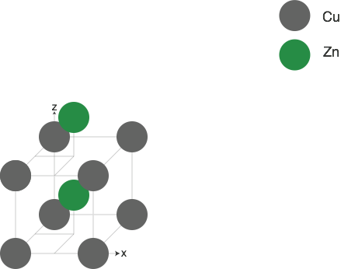
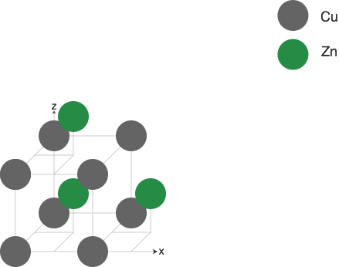
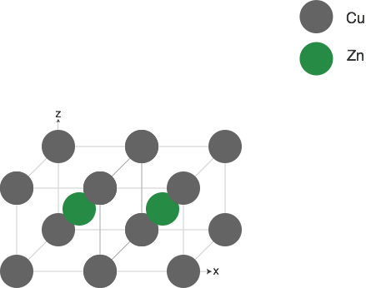
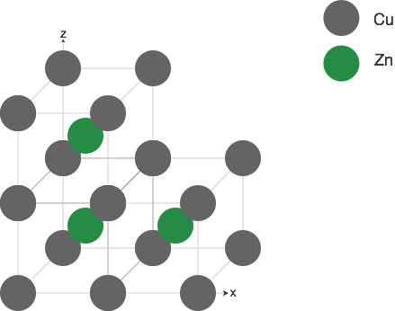
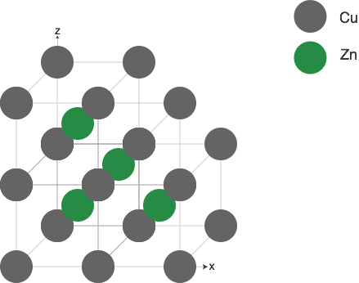
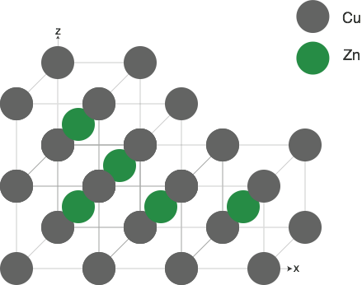
Building a crystal structure
Use example of CuZn brass
Choose the unit cell - for CuZn: primitive cubic (lattice point on each corner)
Choose the motif - Cu: 0, 0, 0; Zn: ½,½,½
Structure = lattice +motif => Start applying motif to each lattice point
Extend lattice further in to space

Slide 7
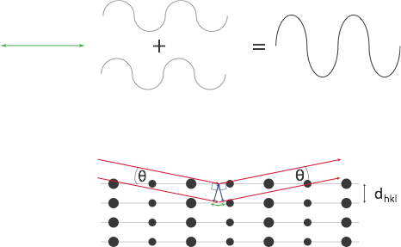
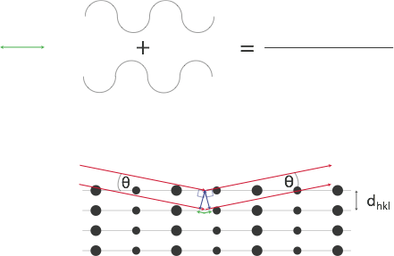
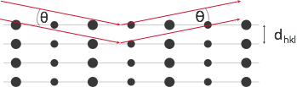
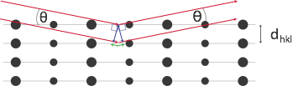
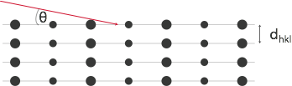
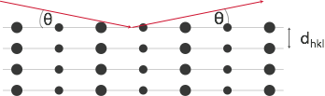

Diffraction theory - Bragg law
Path difference between reflection from planes distance dhkl apart = 2dhklsinθ
=> Bragg law:
nλ = 2dhklsinθ
2dhklsinθ = λ/2 - destructive interference
2dhklsinθ = λ - constructive interference
Electron diffraction: λ ~ 0.001 nm
therefore: λ << dhkl
=> small angle approximation: nλ ≈ 2dhklθ
Reciprocity: scattering angle θ ~ dhkl⁻¹

Slide 8
Bragg’s law
“1”
2 sinθ d_{hkl} = n λ
Incoming wave
“2”
“1”
d_{hkl} = n λ/2 sinθ
Outgoing wave
λ
“2”
θ
θ
Difference in path
d
Distance between lattice planes
Elastic diffraction
|k| = |k’|
k
k’
Periodic arrangement of lattice planes:
g : reciprocal lattice vector
g = k-k’

Slide 9


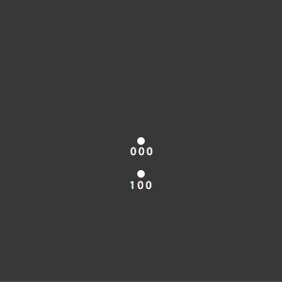
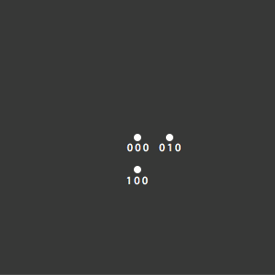
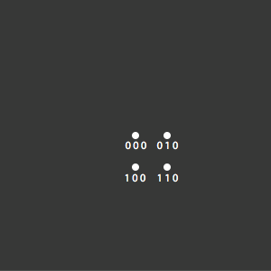
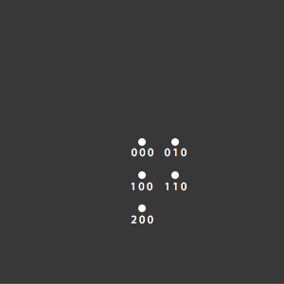
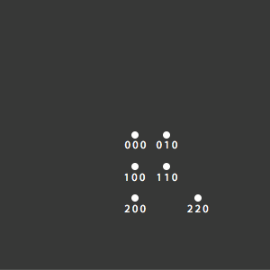
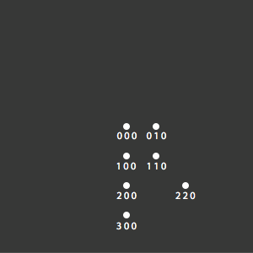
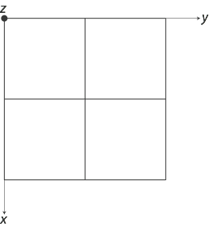
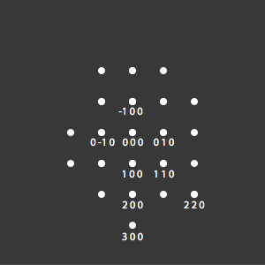
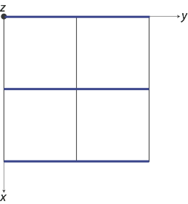
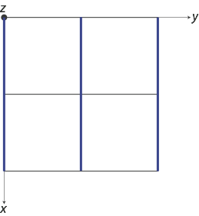
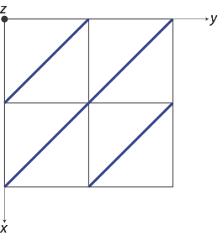
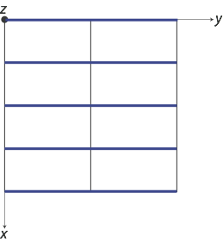
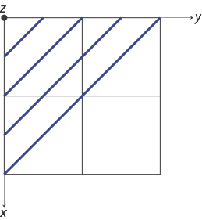
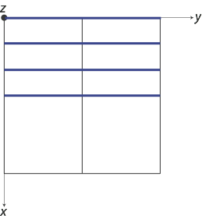
Multi-beam scattering condition
Electron beam parallel to low-index crystal orientation [U V W] = zone axis
Crystal “viewed down” zone axis is like diffraction grating with planes parallel to e-beam
In diffraction pattern obtain spots perpendicular to plane orientation
Example: primitive cubic with e-beam parallel to [0 0 1] zone axis
2 x 2 unit cells
Note reciprocal relationship: smaller plane spacing => larger indices (h k l)
& greater scattering angle on diffraction pattern from (0 0 0) direct beam

Slide 10

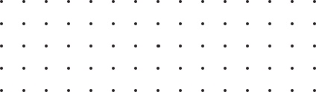

The reciprocal lattice
In diffraction we are working in “reciprocal space”; useful to transform the crystal lattice in to
a “reciprocal lattice” that represents the crystal in reciprocal space:
Real lattice
vector:
rn = n1a + n2b + n3c
Reciprocal lattice
vector:
r* = m1a* + m2b* + m3c*
where:
a*b = a*c = b*c = b*a = c*a = c*b = 0
a*a = b*b = c*c = 1
i.e.
a* = (b ^ c)/VC
VC: volume of unit cell
For scattering from plane (h k l) the diffraction vector:
ghkl = ha* + kb* + lc*
Plane spacing:

Slide 11
Ewald sphere
A vector in reciprocal space:
g_{hkl} = h a* + k b* + l c*
diffraction if :
k_{I} – k_{D} = g and |k_{I}| =|k_{D}|
Bragg and elastic scattering
reciprocal space
k_{I}
real space
a*
b*
kI: incident beam
wave vector
Bragg: d_{hkl} = λ/2 sinθ = 1/ |g|
Reciprocal space: sphere radius 1/λ represents possible scattering wave vectors intersecting reciprocal space
Electron diffraction: radius of sphere very large compared to reciprocal lattice
=> sphere circumference almost flat

Slide 12
Ewald sphere
A vector in reciprocal space:
g_{hkl} = h a* + k b* + l c*
diffraction if :
k_{I} – k_{D} = g and |k_{I}| =|k_{D}|
Bragg and elastic scattering
reciprocal space
k_{D}
real space
k_{I}
a*
b*
kI: incident beam
wave vector
kD: diffracted
wave vector
Reciprocal space: sphere radius 1/λ represents possible scattering wave vectors intersecting reciprocal space
Electron diffraction: radius of sphere very large compared to reciprocal lattice
=> sphere circumference almost flat

Slide 13
Laue Zones

Slide 14
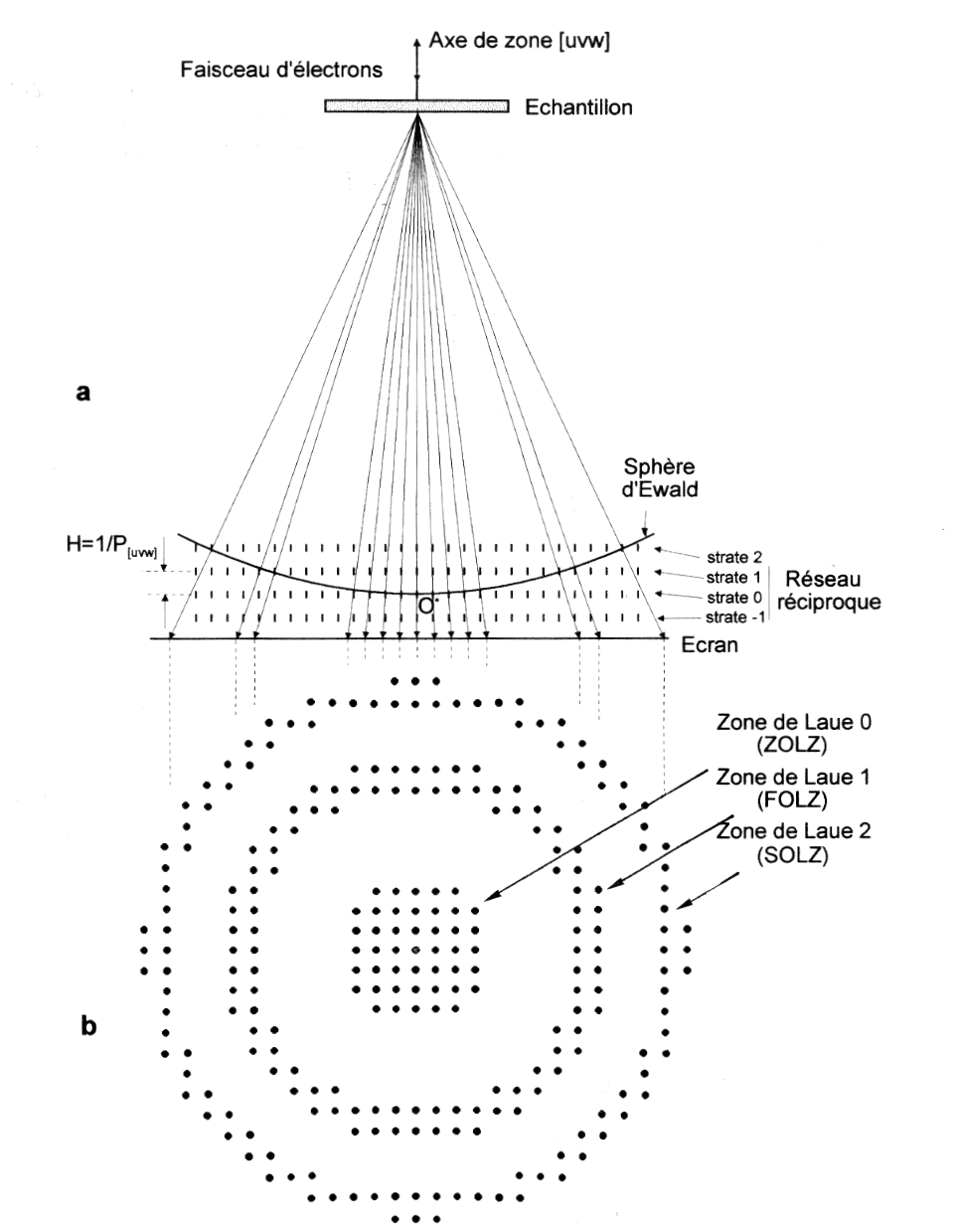
Laue zones
J.-P. Morniroli

Slide 15


Ewald Sphere : Laue Zones (ZOLZ+FOLZ)
ZOLZ
6-fold
Source: P.A. Buffat
FOLZ
3-fold
α=2.0mrad
s=0.2

Slide 16

Ewald Sphere: Laue Zones (ZOLZ+FOLZ) tilted sample
ZOLZ
6-fold
FOLZ
3-fold
α=2.0mrad
s=0.2

Slide 17

Dynamical scattering
For interpretation of intensities in diffraction pattern, single scattering would be ideal
- i.e. “kinematical” scattering
However, in electron diffraction there is often multiple elastic scattering:
i.e. “dynamical” behaviour
This dynamical scattering has a high probability because a Bragg-scattered beam
is at the perfect angle to be Bragg-scattered again (and again...)
As a result, scattering of different beams is not independent from each other

Slide 18


Dynamical scattering thickness fringes

Slide 19



Symmetry information
Zone axis SADPs have symmetry closely related to symmetry of crystal lattice
Example: FCC aluminium
[0 0 1]
[1 1 0]
[1 1 1]
4-fold rotation axis
2-fold rotation axis
6-fold rotation axis - but [1 1 1] actually 3-fold axis
Need third dimension for true symmetry!

